Slide 1
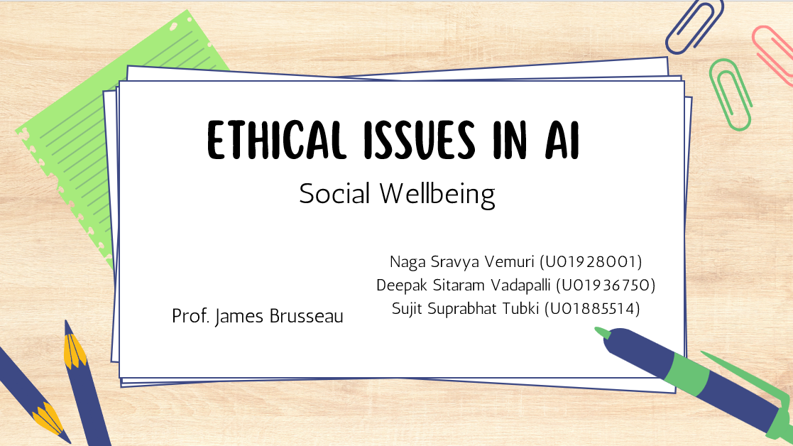

Slide 2
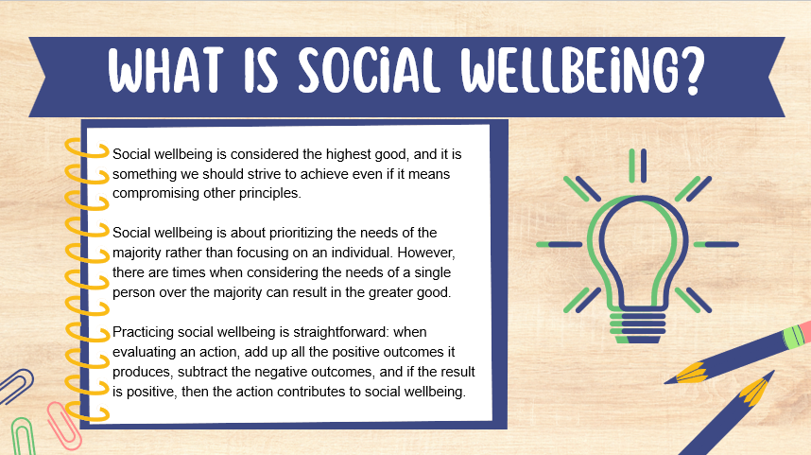

Slide 4
Examples of Social Wellbeing

Slide 6
Should we ban facial recognition?
Usage of facial recognition in public
Facial recognition in crisis
Does it help social wellbeing?

Slide 8
facial recognition technology in other ethics
Privacy: Facial recognition technology poses privacy risks by collecting and storing sensitive biometric data, often without individuals’ consent.
Fairness: The technology has been less accurate for individuals with different skin tones, leading to unfair treatment and potential misidentification.

Slide 9
DrIverless cars
Driverless cars, also known as autonomous vehicles, are equipped with advanced technologies that allow them to navigate and operate without human intervention.
Driverless cars utilize artificial intelligence (AI) as a core component of their technology, enabling them to navigate, make decisions, and operate safely without human.

Slide 10
SCENARIO 1

Slide 11
ScenarIO 2

Slide 12
HOW IS HAPPINESS/SADNESS RELATED ?

Slide 13
Thank you!

